Slide 1
AI Discoveries
While Developing the Magic 8 Ball
By: 2020 Visionaries

Slide 2
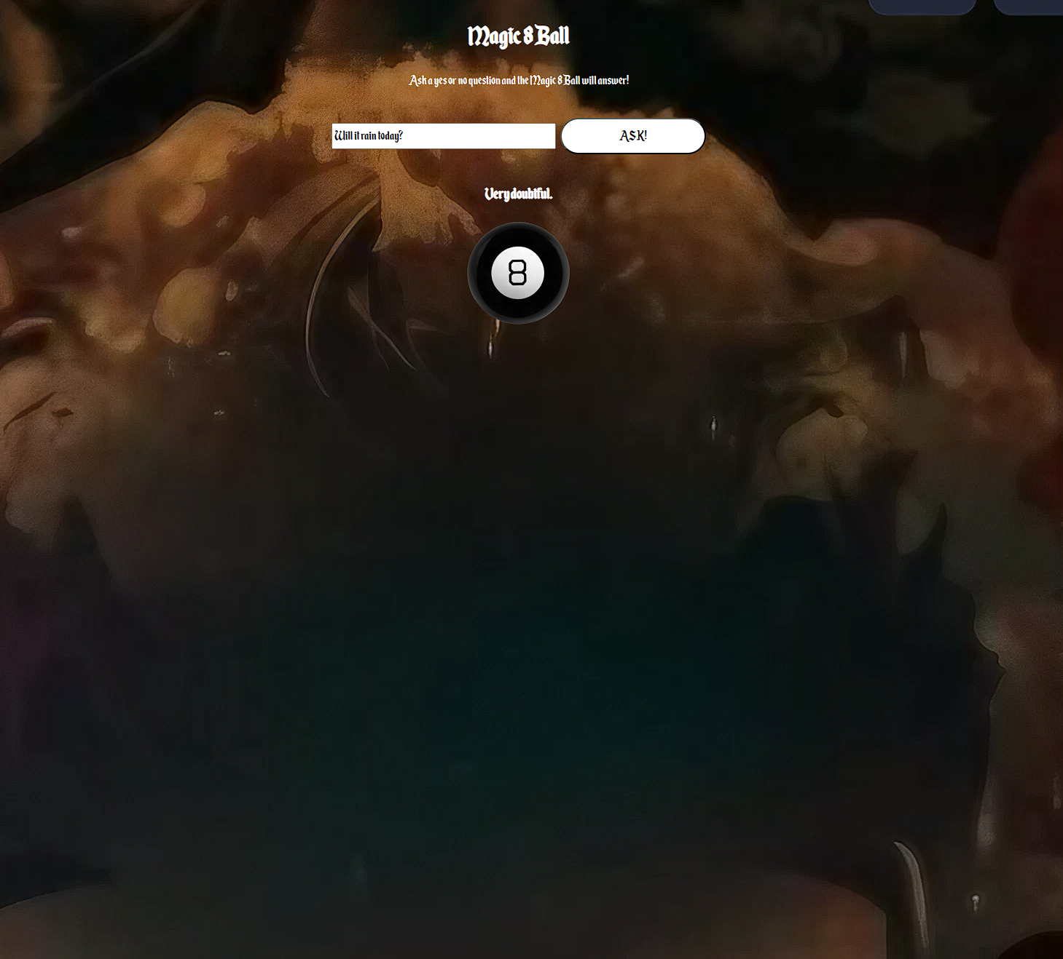
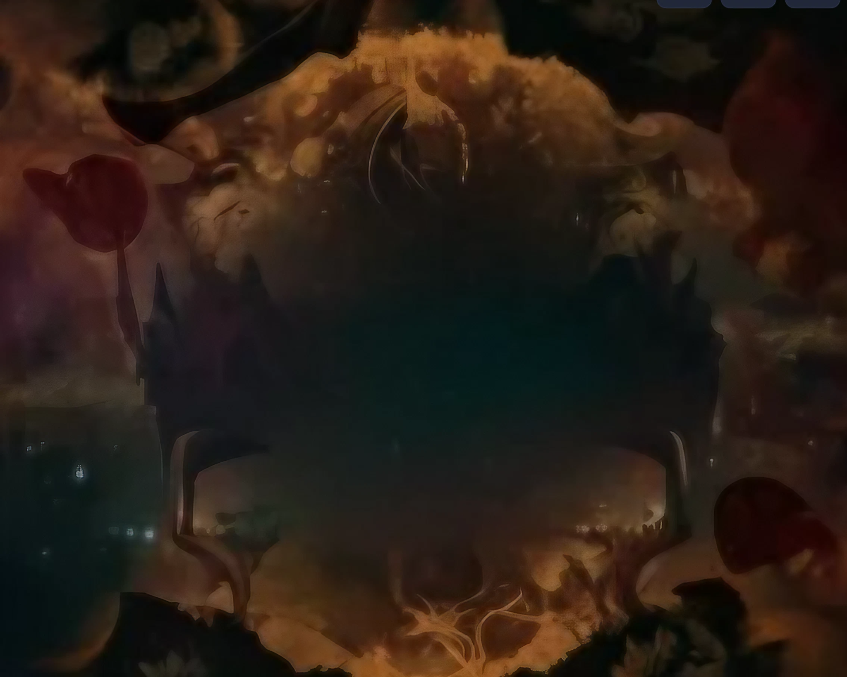
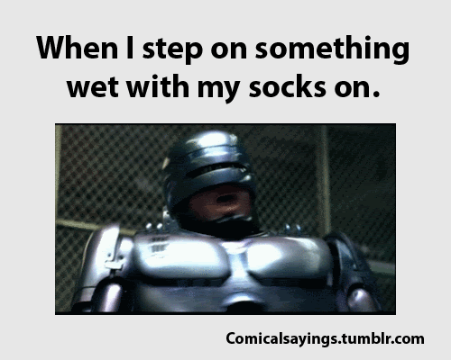
01.
02.
03.
Code
Background
Voice Over
The basic functionality of our website was created mostly by ChatGPT
We used an AI image generator to make the background for us
We used an AI to voice over some lines for our magic 8 ball

Slide 3
01.
Code Generation
What we learned about code generation AIs

Slide 4

ChatGPT
Good Base
The code generated by ChatGPT 3.5 gives you a good basic foundation to build off of which actually works!
Good Feature Builder
If you give ChatGPT your code and tell it to add a feature it can usually do it quite well.
Bad UI Designer
ChatGPT is not great at creating visually appealing designs. This could also be due to the lack of specificity in our prompts, but also because ChatGPT uses a language model and is not very good at anything visual (images, design, etc.)

Slide 5
02.
Image Generation
What we learned about image generating AIs

Slide 6

PAYWALL ❌
Midjourney
Waittime↓
Quality↑
DISCORD
Midjourney is advertised as being free (free trial), but when we tried to use the /imagine prompt we learned that the service was currently only available to subscribers due to extreme demand
From what we could see, paid users were getting responses pretty quickly (in seconds)
“/imagine a simple magic 8 ball icon for a website”
The images that we could see were really good. The more specific the prompt, the less variety there were in the results. Photorealistic images were shockingly realistic and likewise with environmental renders.

Slide 7

FREE
Slow
Low Res
Watermark
Craiyon was the first image generation AI we found that didn’t have a paywall to generate/view images!
Images take >1 minute to produce, but can be sped up to ~15 seconds if you pay for a subscription.
Images were batch generated and could be upscaled for free, but were still low resolution/blurry even after processing
All images generated using the free version of Craiyon had a watermark on the bottom right corner

Slide 8
03.
Audio Generation
What we learned about sound/audio generating AIs

Slide 9

Great variety of voices, but many are locked behind a paywall. The voices that are available however sound kind of robotic in their pacing. Free users are unable to download any audio generated by the site, which is unfortunate.

Slide 10
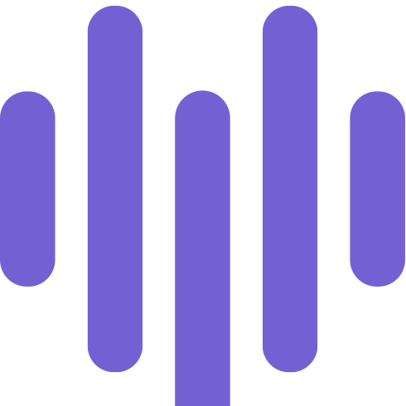
Lovo AI
Variety
Tone
Good enough quality and there is a large variety of voices to choose from. It also seems like we can create a lot of difference voice lines for free (20 minutes worth) on a free account..
There is still a lot left to be desired from the quality of the voice: normal human voices still sound a bit robotic, and some lines weren’t being expressed like the way we wanted (adding a ! or ? to the end of a sentence does not change how the sentence is dictated). But if you choose a more “fantasy” inspired voice like “villain” or “santa”, the robot-ness mostly goes away.

Slide 11
Thanks!
Resources Used During This Exploratory Project:
ChatGPT
Craiyon
Lovo AI

